Slide 1
E-commerce Case Study: Increase Gross Revenue
Le Thanh Long

Slide 2
Agenda
Introduction
Problem Structure
Analysis
Summary
Questions and Answers

Slide 3
I. Introduction
Seller A, one of our clients, achieved 10 Billions+ VND for gross revenue in July 2019.
They want to double the gross revenue to 20 Billions VND in August 2019.
Responsibility: provide a plan on how to achieve the KPI

Slide 4
II. Problem Structure
How and where to double the sales in August?
Past performance
Date Sales Volume and Frequency
Prices and Discounts
Customers
Traffics
Order status
Page per Session
Revenues
Payment methods
Customers Segmentation
Notes:
Before dive deeper, need to structure the problem
How and where to double the sales in August
Three crucial data to investigate

Slide 5
III. Analysis

Slide 6
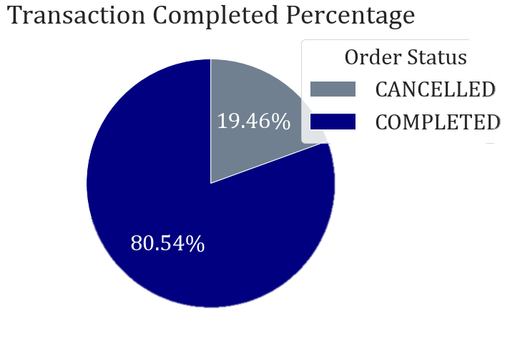
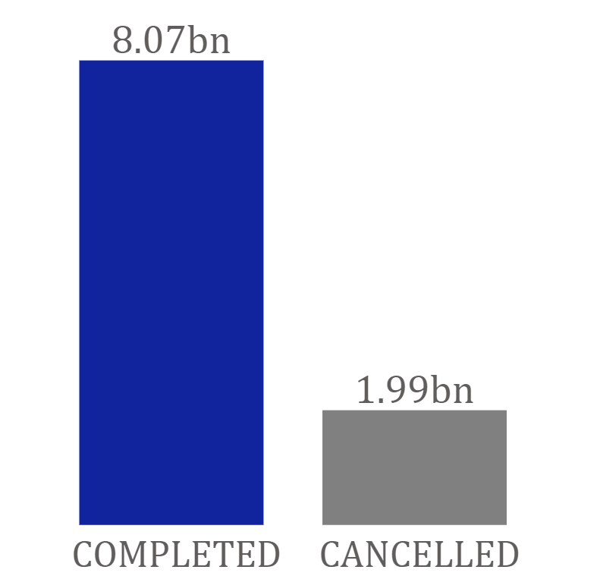
1. July Sales Performance
Active Customers
30,513
Total Transactions
61,728
Gross Revenues
8.07 Billion
Average Order Made 1.82
Average Item Purchased
1.11
49.72K
Notes:
31.5 thousand
61.7 thousand
Real gross revenue: only 8billion VND
The 2b has lost due to customers cancellation of order, we can see the cancellation percentage was 19.46%

Slide 7
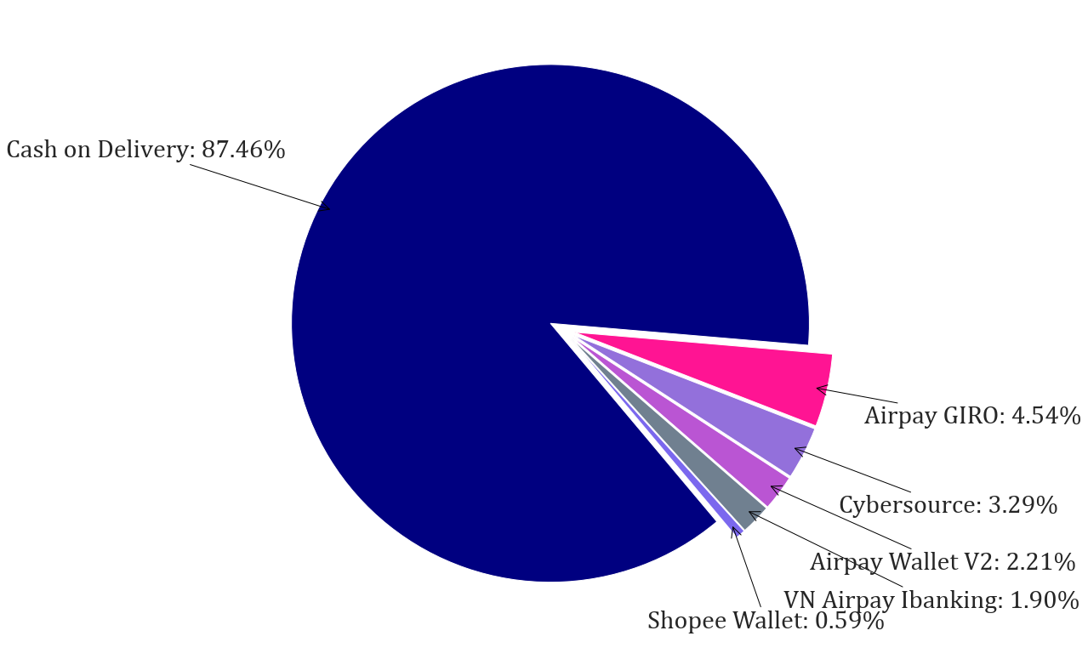
2. Main Payment Method
Percentage of Main Payment Method
Types of Payment Methods:
32
Cash on Delivery: 87.46%

Slide 8
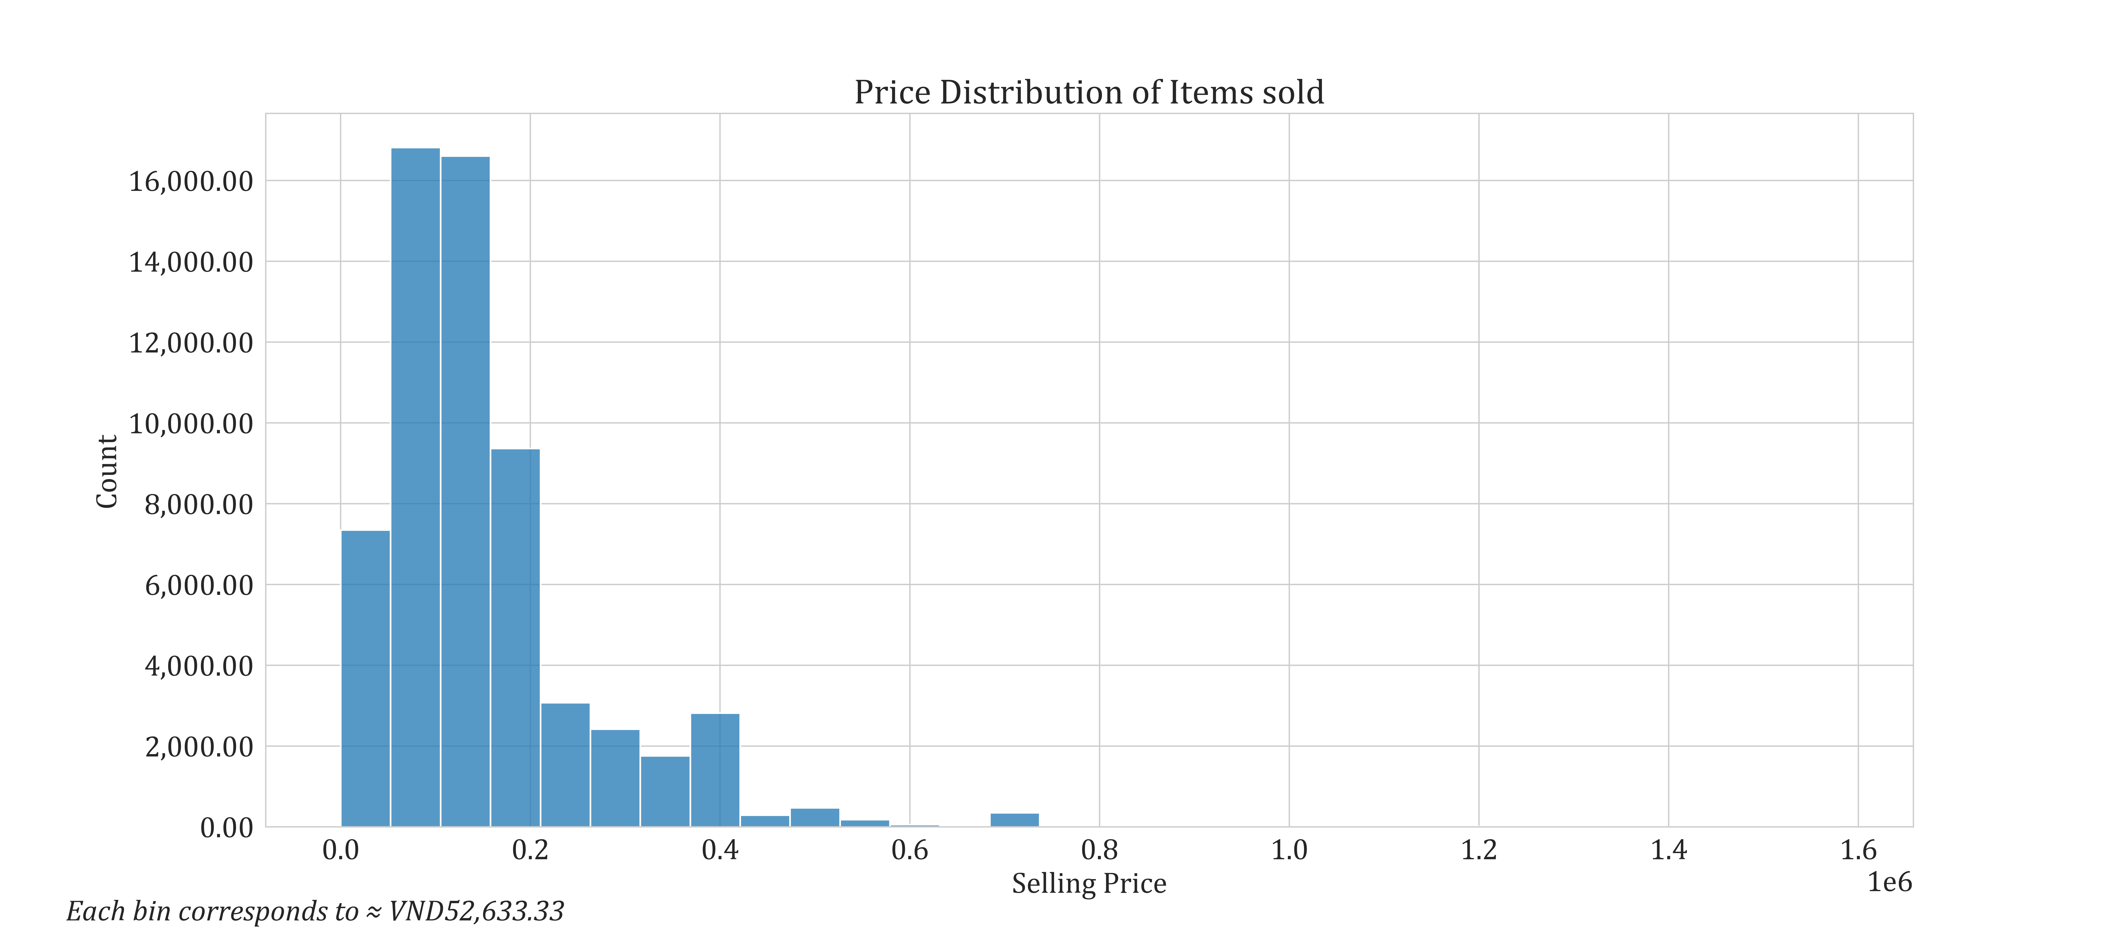
3. Price Distribution of Items Sold in July
Most common purchase price:
VND50,000-200,000

Slide 9
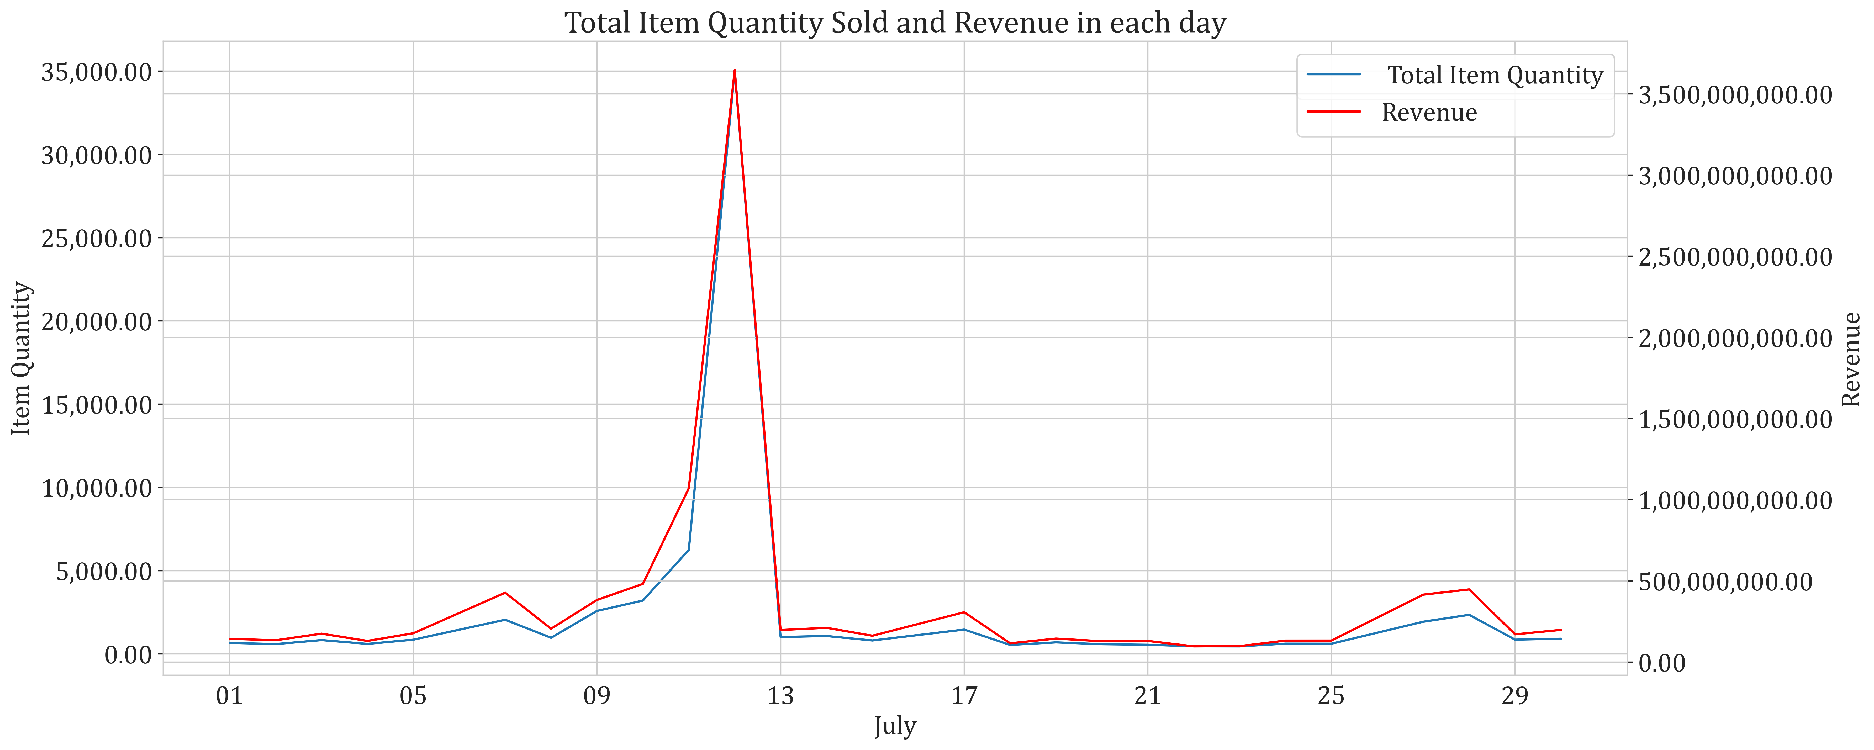
4. Total Sales Volume and Revenue
Highest revenue: VND3,647,118,000
Highest item purchased: 35,073
There was a surge in sales volume in 12th July, 2019

Slide 10
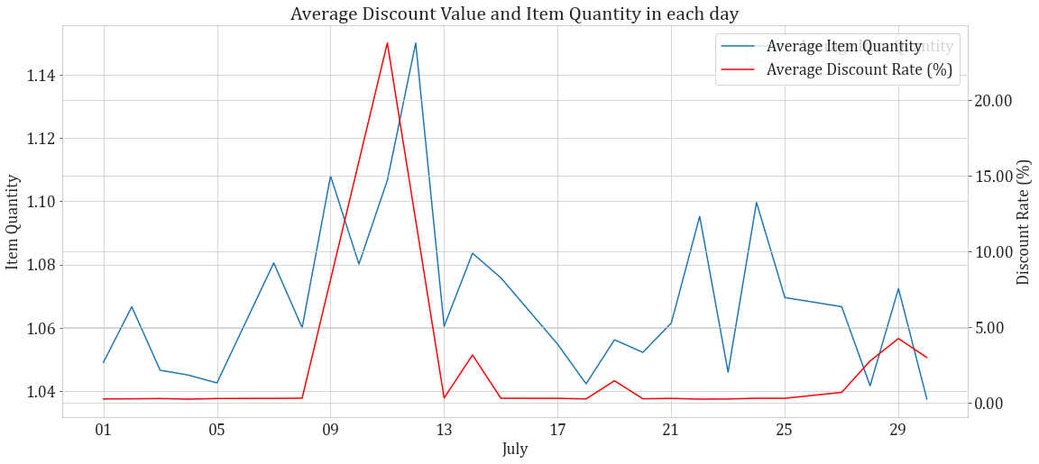
5. Average Date Sales Volume
Salary pay dates
Beginning of month

Slide 11
Recommendation: Boost Promotions at The Latter-half of Month

Slide 12
Customers Profile

Slide 13
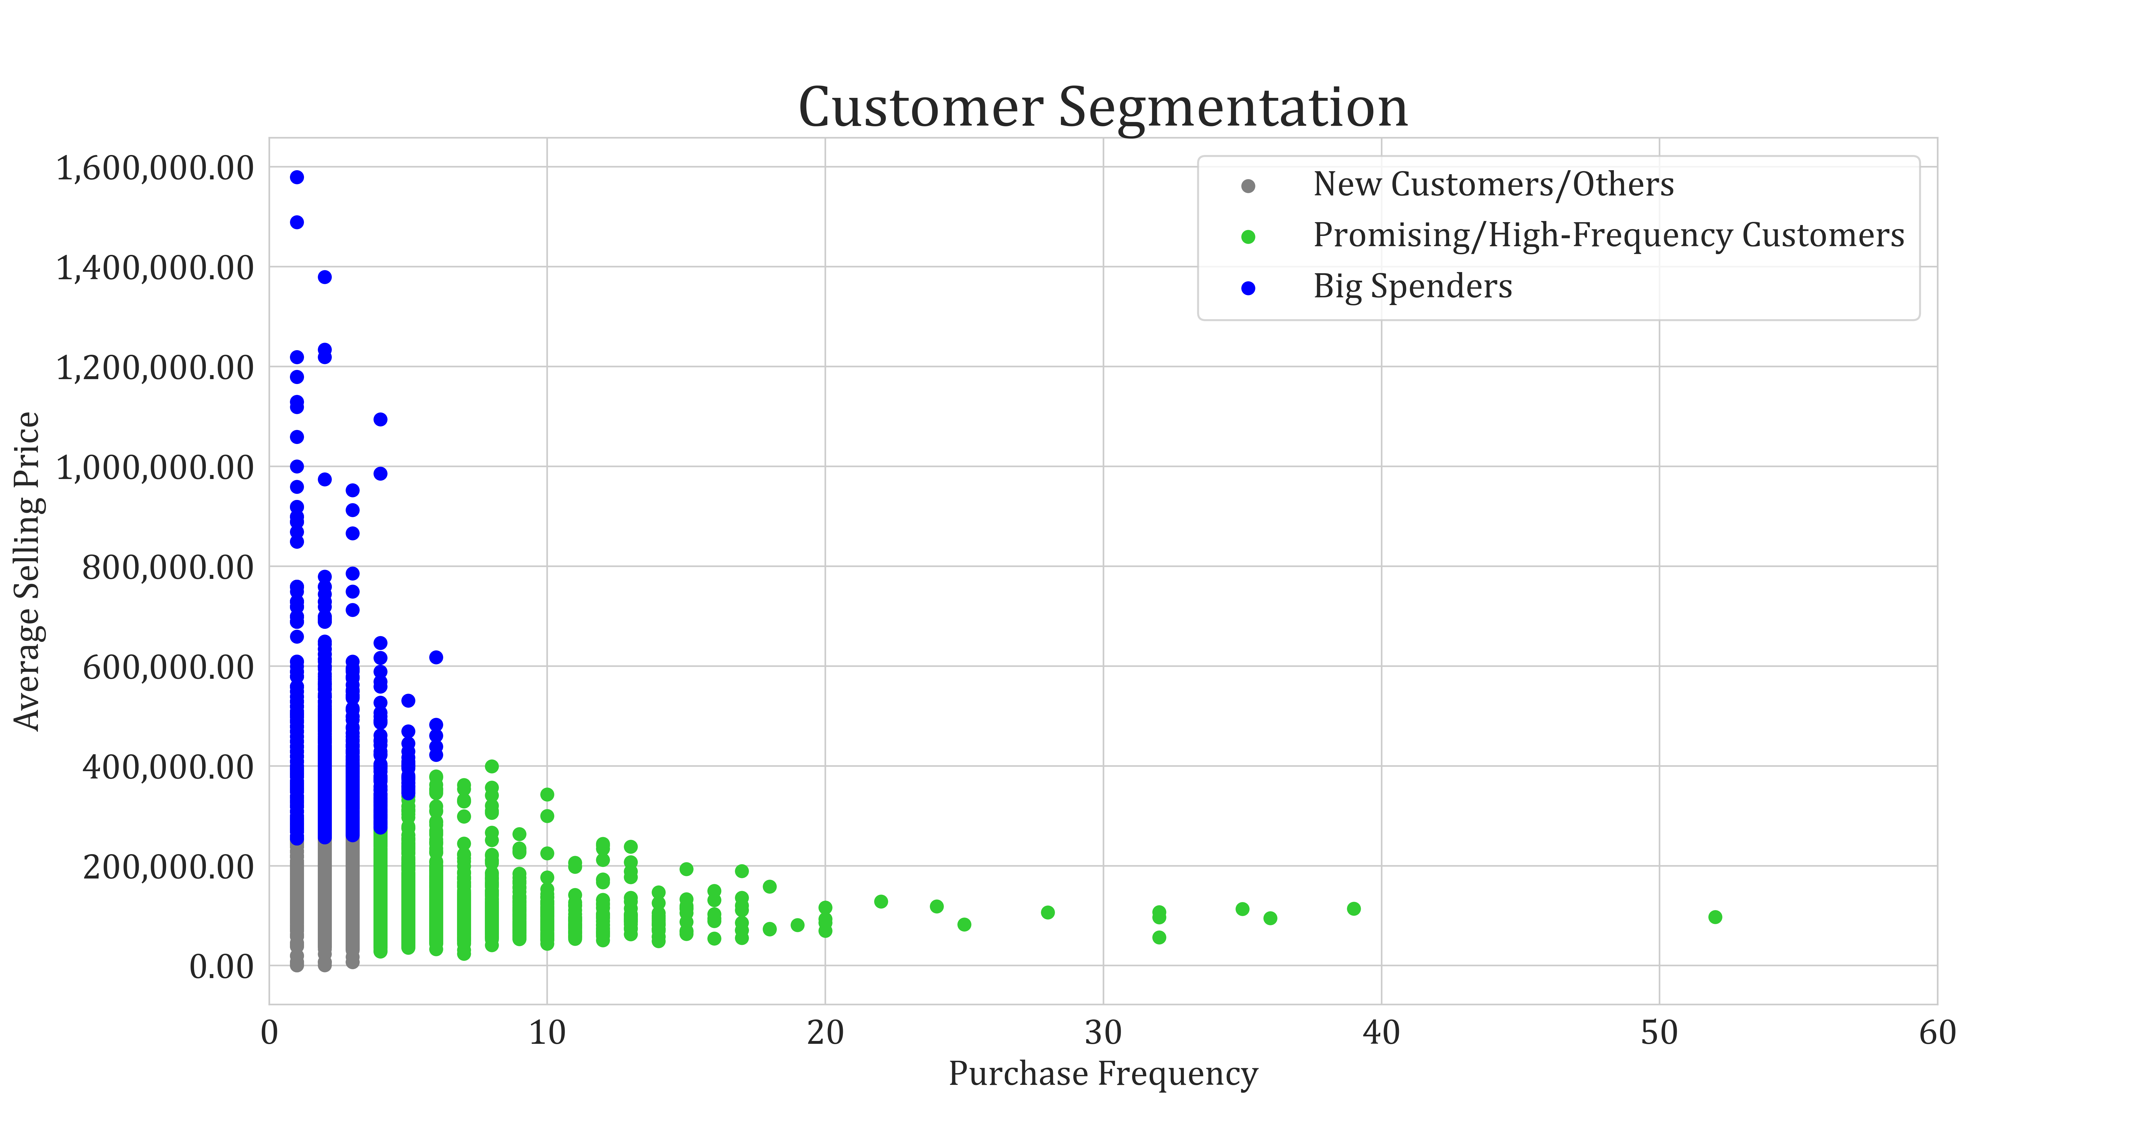
6. Customer Segmentation
Notes:
Pie chart representing customers buying behaviours in Frequency and Average Item Value

Slide 14
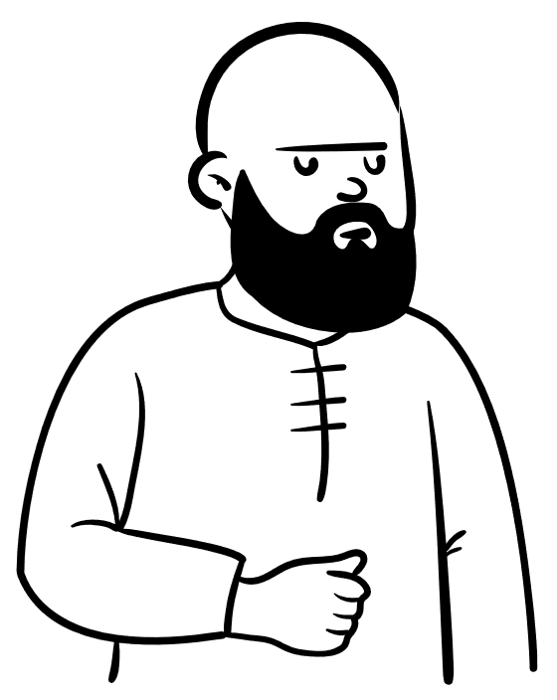


7. Recommend Promotions
New Customers/Others
Population: 21,368
Total Transaction: 34,825
Price Range:
VND 1K- 259K
Std: VND 43,918.28
Big Spenders
Population: 5,716
Total Transaction: 7,648
Price Range:
VND 255K-1.58m
Std: VND 137,456.1
High-Frequency Customers
Population: 3,429
Total Transaction: 19,255
Price Range:
VND 24K-399K
Std: VND 50,428
Notes:
New customers segment has the highest number of Customers..,followed by Big Spenders, the last is High-Frequency Customers

Slide 15
8. Recommend Promotions
New Customers/Others
Membership Offers
First-time Discount
Mix promotions
Goal: Attract and retain customers, convert them into other segments
Big Spenders
High-Frequency Customers
Bundling/Up-Sells
Recommend/Discount High-quality or Luxury Products
Goal: Increase Value per Order
Product Recommendations
Free-shipping
Flash-sales
Goal: Increase Purchasing Frequency

Slide 16
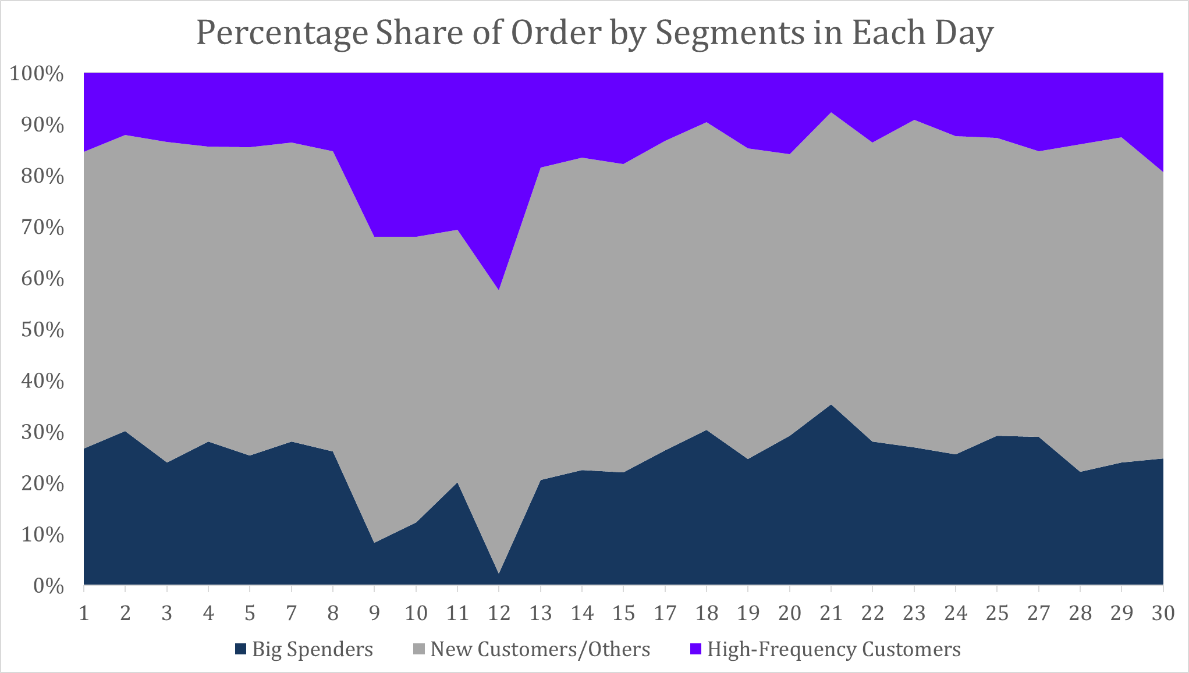
9. What Time Did Customers Purchase?

Slide 17
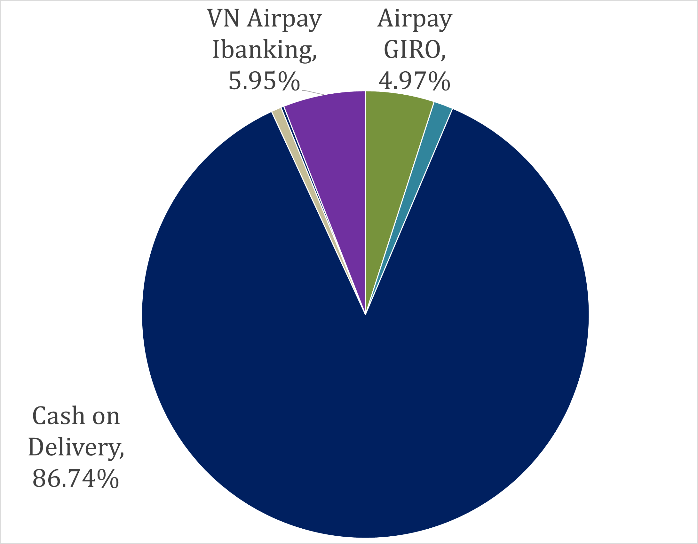
10. Order Cancellation
Cancellation By Main Method
Cancellation of Order each Method
Notes:
We could increase revenue by decreasing Order Cancellation

Slide 18
Customers might have cancelled their order for:
Repurchase
Mistake
Adding Items
Lost Interest
Need more data to investigate further
Recommendation: Encourage conversion to electronic payments

Slide 19
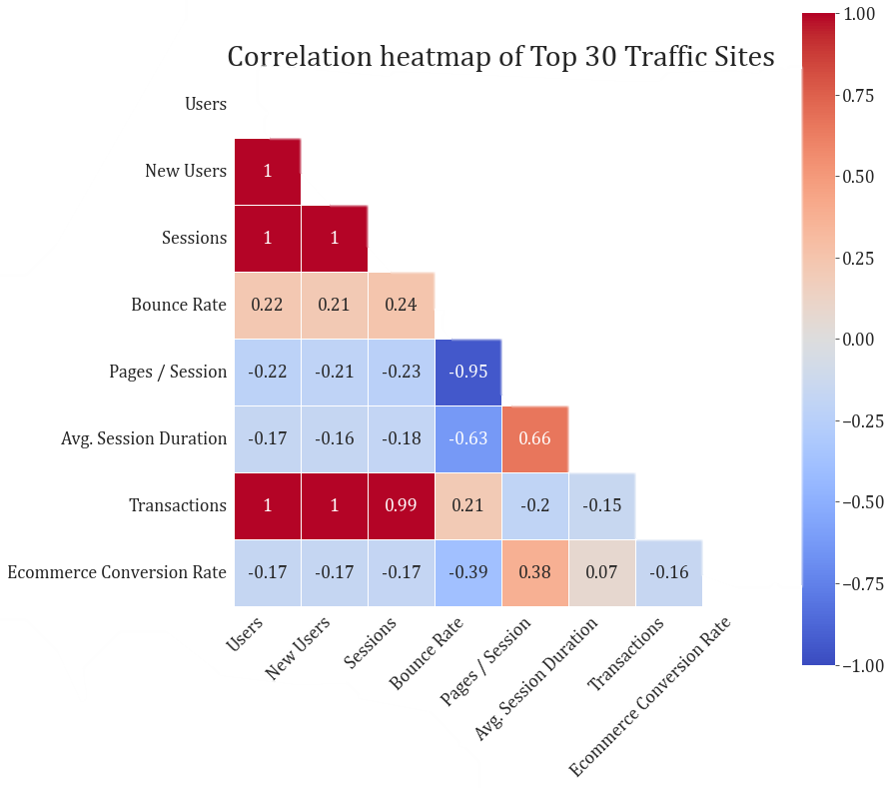
11. Correlation Heatmap of Top 30 Traffic Sites

Slide 20

Traffic sites’ Strategic Map
High
Youtube (Social)
Facebook (Social)
Messenger (Local Display)
Youtube (Referral)
GoogleAPIs
Zalo
(Referral)
Bounce Rate
Customers Leaving at First Page
Facebook
(Referral)
Newsletter (Email)
Google (Cost per Click)
Low
Pages / Session
High
Dot size represents Traffic Users
Customers Engagement with Content
Notes:
With the High amount of New Customers, I recommend Seller A to adjust Strategy for traffic sites based on Customer Attracting and Engaging purpose. This Map represent this strategic recommendation.

Slide 21
Traffic sites’ Strategic Map
High
Need Improvement
Customer Feedback
A/B Testing
Optimise Internal Linking
Improve Website Design and User Experience
Target Right Audiences
Offer Incentives
Youtube (Social)
Facebook (Social)
Messenger (Local Display)
Youtube (Referral)
GoogleAPIs
Zalo
(Referral)
Bounce Rate
Customers Leaving at First Page
Potential
Improve Website Navigation
Use Engaging and Relevant Content
Top Performance
Personalisation
Facebook
(Referral)
Newsletter (Email)
Google (Cost per Click)
Low
Pages / Session
High
Dot size represents Traffic Users
Customers Engagement with Content
Notes:
With the High amount of New Customers, I recommend Seller A to adjust Strategy for traffic sites based on Customer Attracting and Engaging purpose. This Map represent this strategic recommendation.

Slide 22
IV. Summary: Plan to Double the Revenue
Boost Higher Promotions at Latter-half of Month to Scalp Customers Pocket.
Time-limited Promotion: Expire at Month’s end.
Optimise Promotions for Each Customer Segment
Big Spenders: Recommend/Offer High-quality, Luxury Products (Price Range ≥ VND 400,000. Bundling/Cross-sells.
High-Frequency Customers: Free-shipping, Flash-sells
New Customers/Others: Mix Promotions
Enhance Customer Engagement, Reduce Bounce Rate Across Traffic Site

Slide 23
Thank you
Le Thanh Long
lethanhlong632@gmail.com

